Slide 1
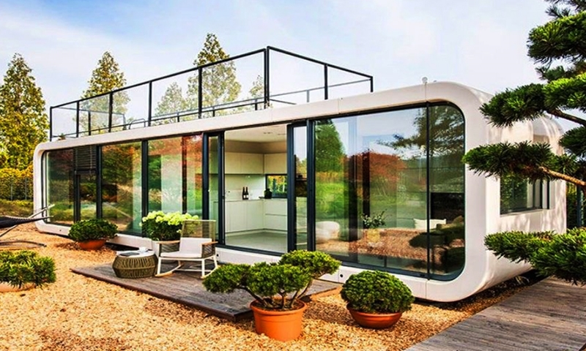







Our commitment to customer satisfaction is the cornerstone of our success. We strive to exceed expectations by delivering exceptional service and innovative solutions, ensuring every client feels valued and heard
Contact
+91 9850969651
+91 9962414238
sales@sotstech.in
www.sotstech.in

Slide 2
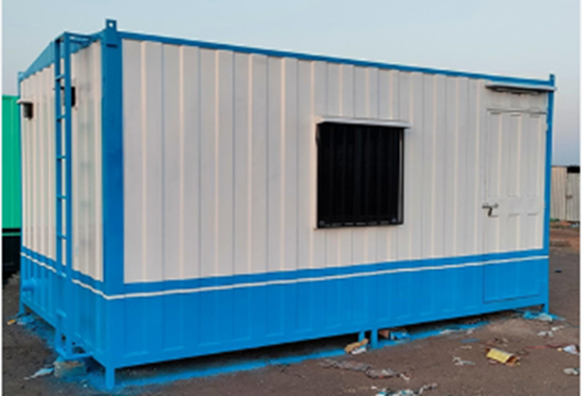
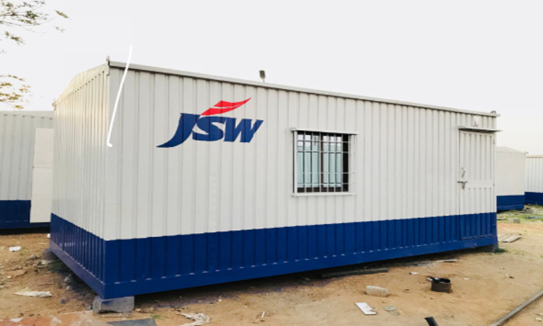
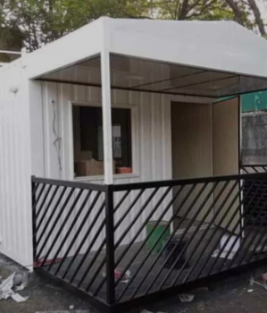
What we are offering
Why JUST-PORTA
Off-site Construction, Faster and More Efficient
On-site Assembly
Reduced Construction Time
Potential Cost Savings
Design Flexibility
Environmental Benefits:
.
Potential market
Modern in design
Wide range of sizes & colors
Customized options to meet design & budgetary
Energy efficient with Solar panel equipped
Ergonomic interior spaces
Weatherproof & corrosion resistant
offering high reliability and durability
Residential buildings
Industrial site office, Bunk house,
Farmhouse/Out house
Resort cottages
Medical room for Rural and Remote Areas
Disaster Relief and Emergency Shelters
Police outpost, chowki
Floor extension of existing RCC building

Slide 3
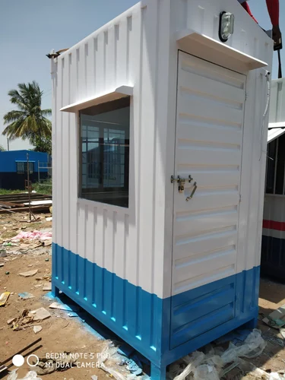
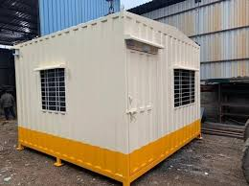
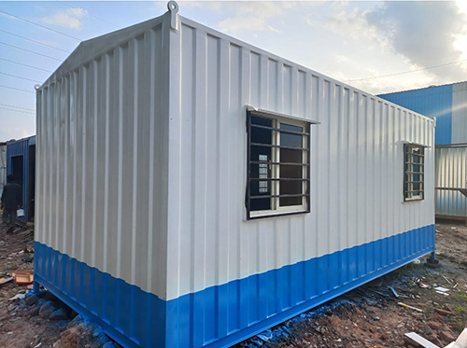
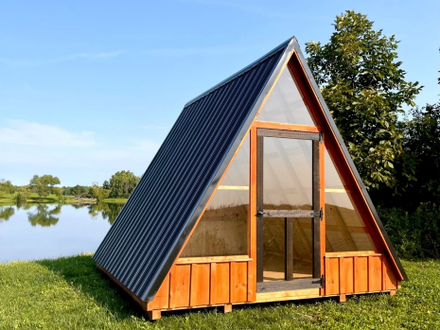
Container sizes Length | External dimensions LxWxH | Useful for
4 ft | 4’ x 4’ x 8.6’ | Toilet, guard cabin
6 ft | 6’ x 4’ x 8.6’ | Security cabin,
8 ft | 8’ x 8’/10’ x 8’6” | Security office, Outhouse
10 ft | 10’ x 8’/10’ x 8’6” | Site office, Police outpost
20 ft | 20’ x 10’ x 8’6” | Site office, Police station, 1RK house
40 ft | 40’ x 10’ x 8’6” | Full site office, Police chowki, 1BHK, Medical room, Bunk house
Customized | As per demand | Customized
4’ x 4’ x 8.6’
6’ x 8’/10’ x 8.6’
20’ x 10’ x 8.6’
Customized
Optional features
Decorative PVC panels
Designer PVC ceilings
External paint as per corporate branding
Internal wall branding
Duplex cabin with designer staircase
Soundproof cabin
Biometric controlled doors
Roof top solar panel
Customized sizes as per need
Furnished for resorts cottages
Furnished Bunk house
Decorative sanitary fittings
Standard specifications
​
Structure- Mild steel (MS) frame with full painted
Walls – 50-75mm PUF panel or glass wool & particle board
Flooring – Aerocon, marine ply
Door-Ply, glass with leak proof
Windows- Aluminum or UPVC Openable
Electricals – LED lights, plug sockets, ceiling fan
Interior finish – Laminated/Particle board/PVC panels
Basic sanitary fittings

Slide 4
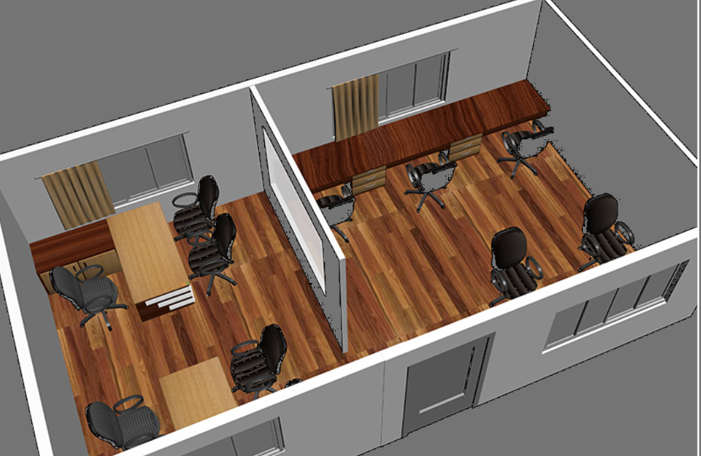
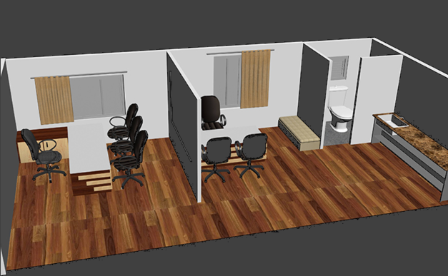
Exterior
Proposed Interior
10’ x 8’ x 8.6’
20’ x 8’ x 8.6’

Slide 5
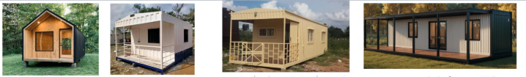
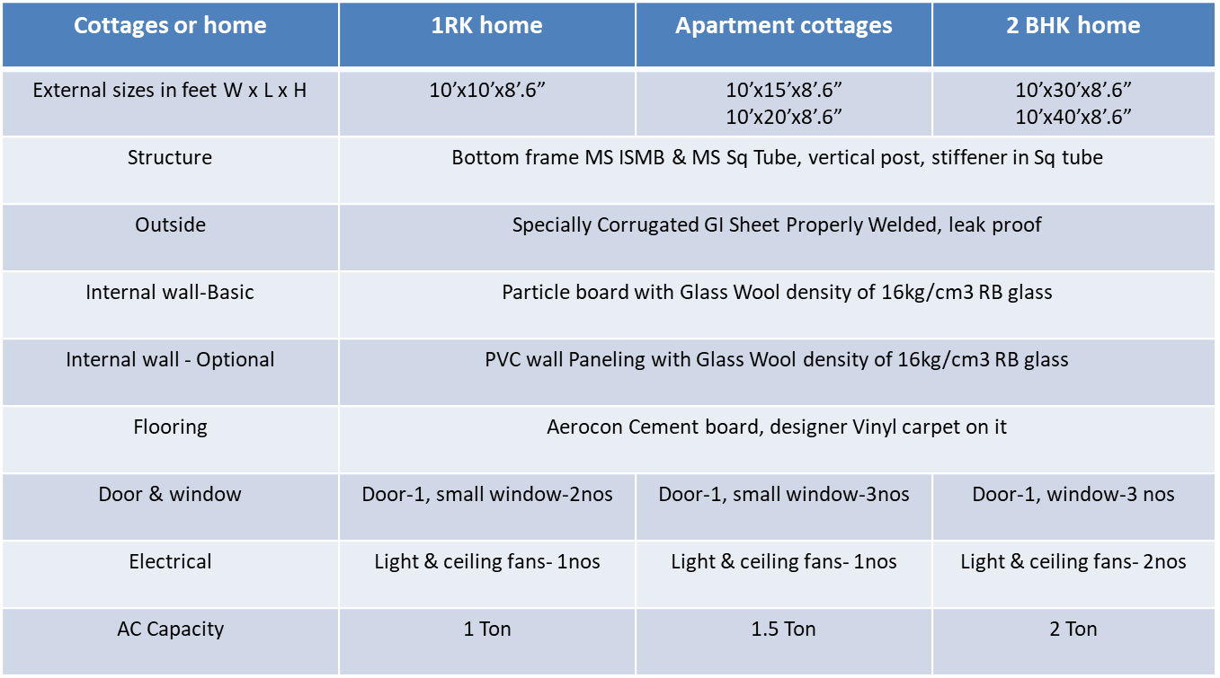
Cottage or Home

